Slide 1
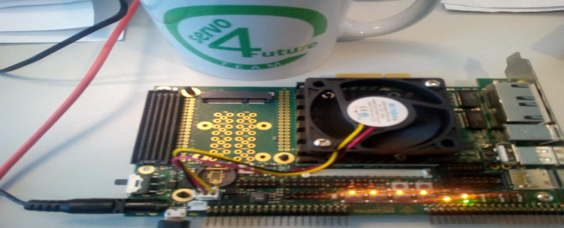
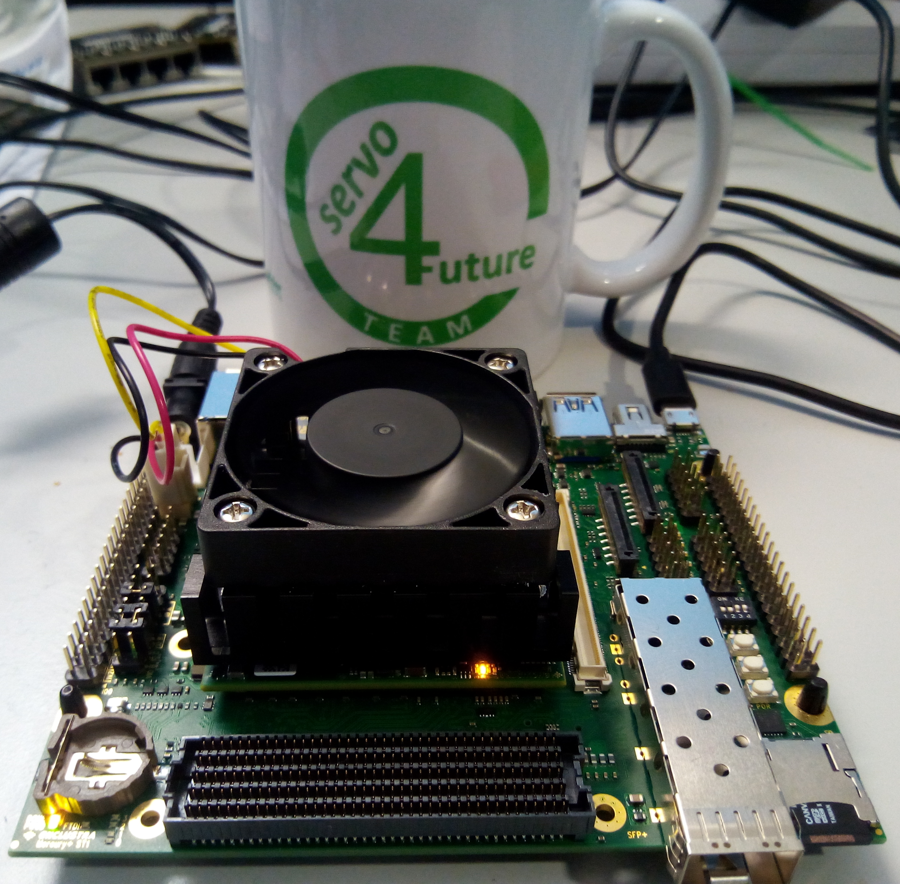
Hands-On PE1 and ST1
XU5 with 2CG and 4EV
Presented by: Klaus Bordt 22.11.2022

Slide 2
Agenda
HandsOn PE1 and ST1
Vivado and Vitis
Carriers and SOMs
Hello World - Import first project
Import XSA file from Vivado
Test –the winners take the boards

Slide 3
1 Vivado and Vitis
Vivado
Vivado ML is a Tool from AMD/Xilinx for Hardware Developers to create, simulate Hardware/VHDL-designs, set constraints for I/O and timing and load the designs on a board . It creates and provides the *.XSA and *.bit Bitstream files for Vitis
Vivado Standard Edition Free 2021.2 used
Vitis
Vitis is a Tool from AMD/Xilinx for Software Developers to program and debug and load on a board. It is based on eclipse and a platform for processor subsystem
Vitis Core Development Kit 2021.2 used

Slide 4
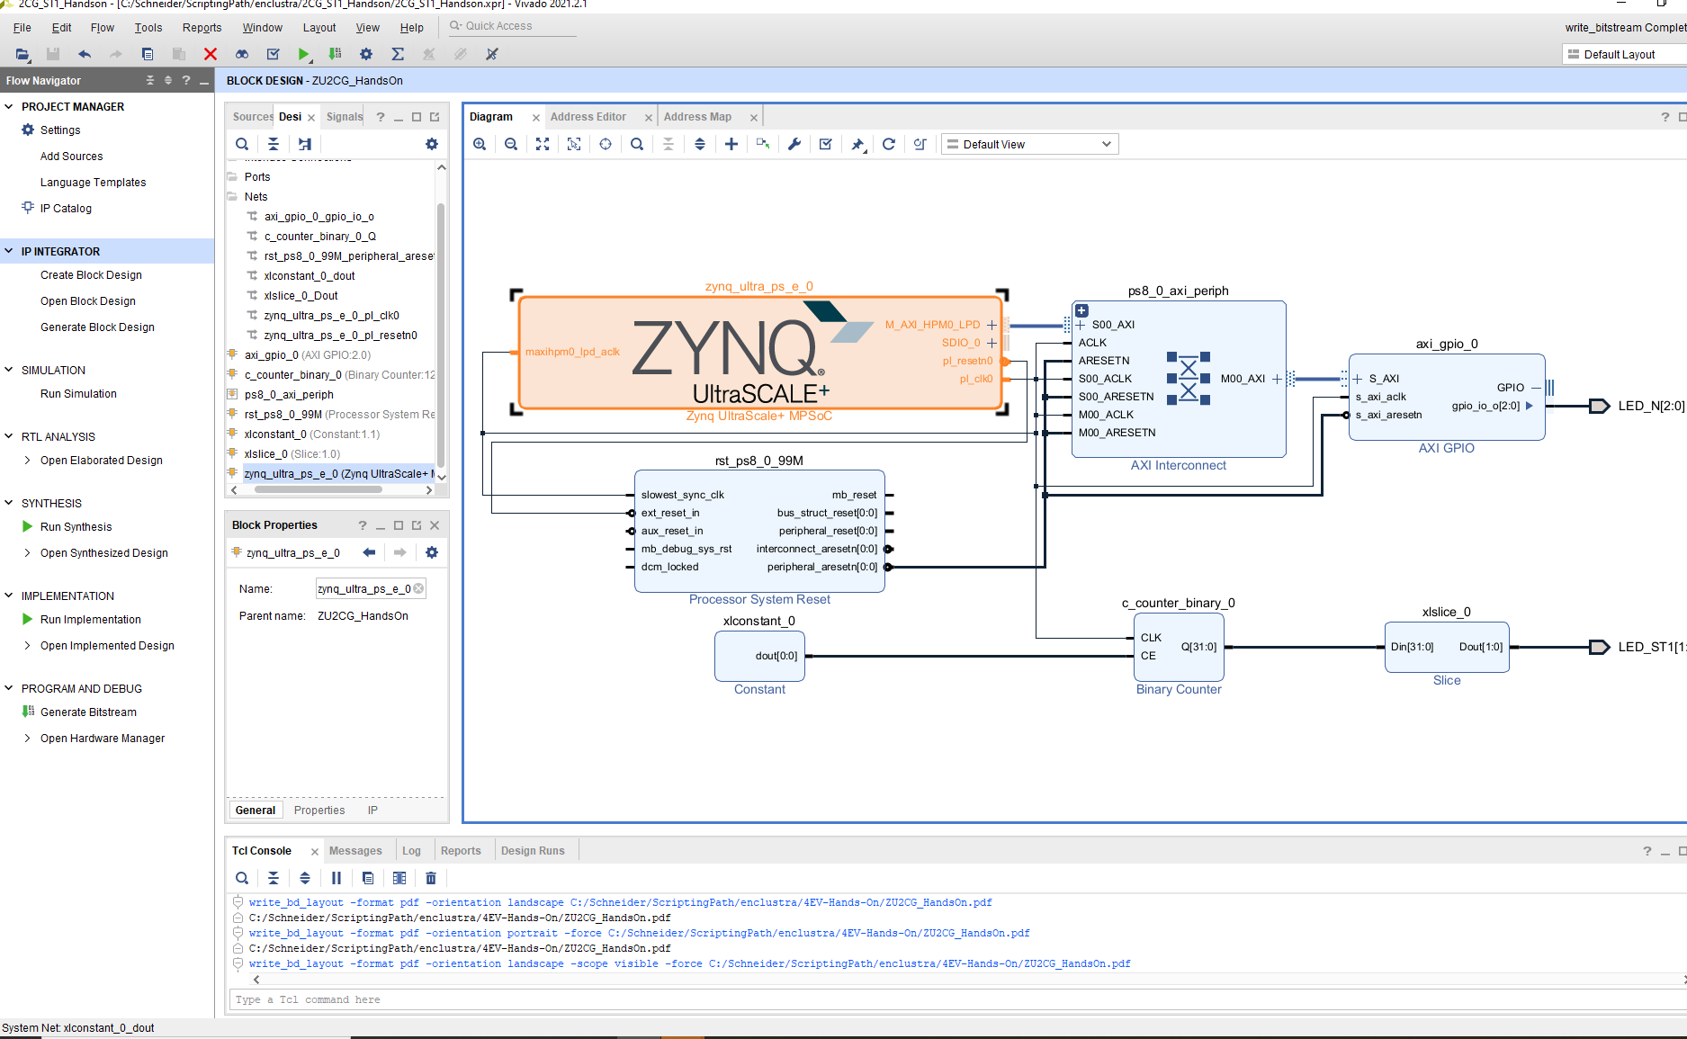
1 Vivado
Tool for Hardware-design
MPSOC configuration
Block Design in the IP Integrator (right window)
Set Constraints
Simulation
Logic debugging
Synthesis and Implementation
Generate Bitstream PL
Export XSA file for Vitis

Slide 5
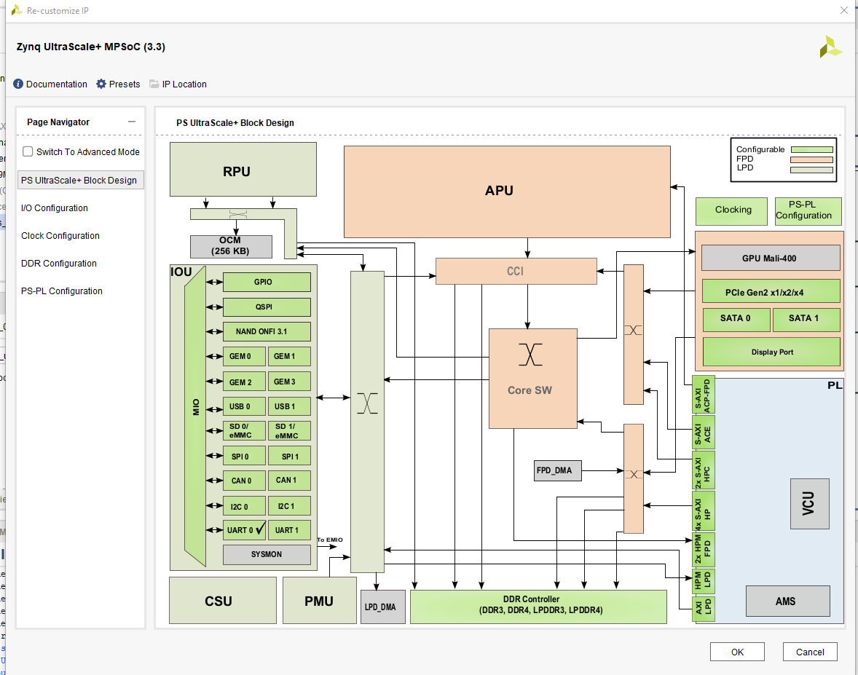
MPSoC Configuration
Zynq Ultrascale+

Slide 6
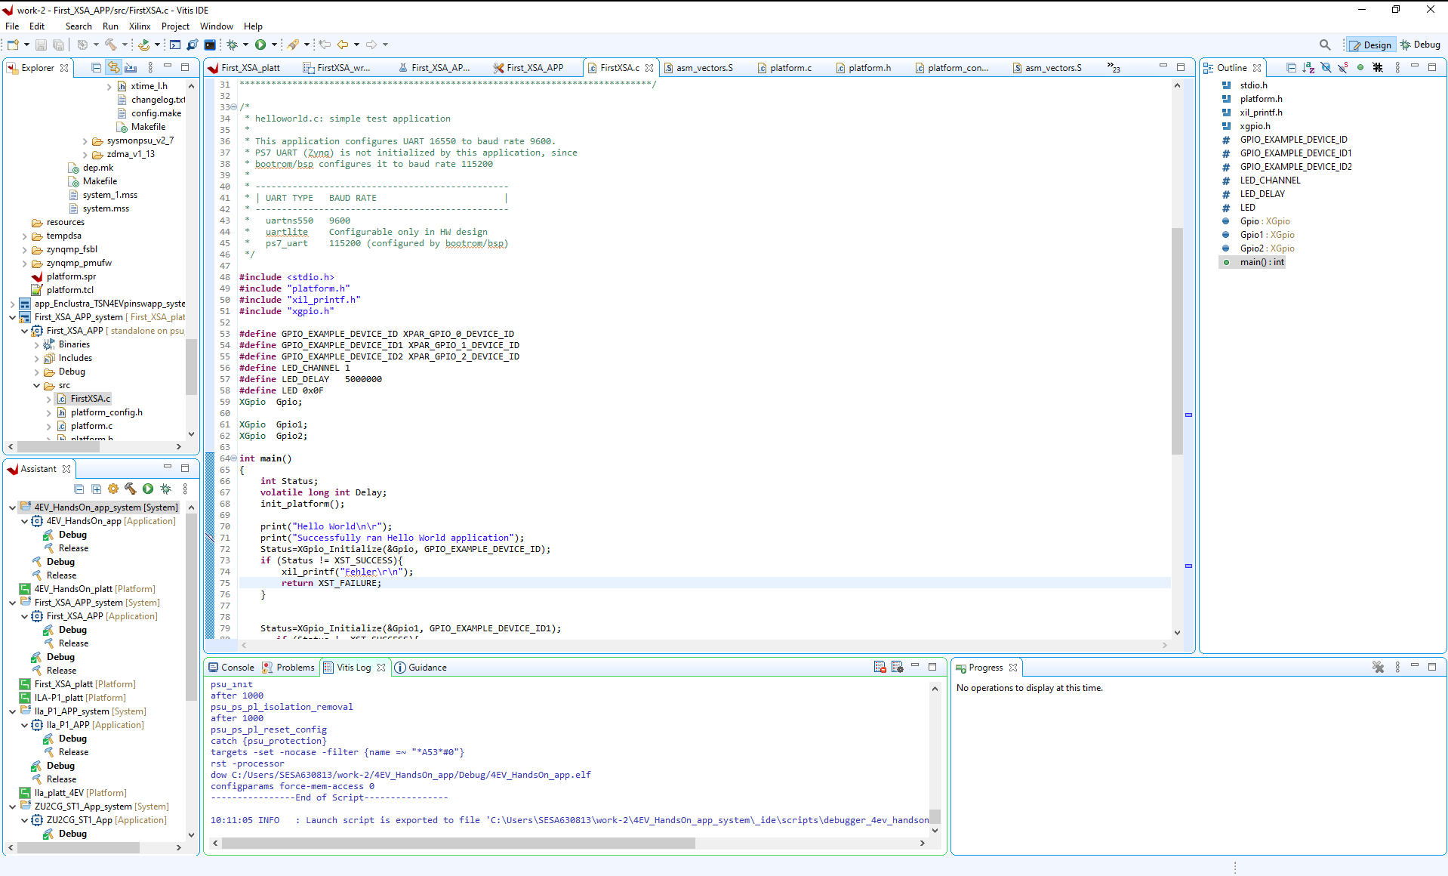
1 Vitis
Eclipse based IDE to program the Processor subsystem
BSP generation
Application developement
Image creation
Run , debug

Slide 7
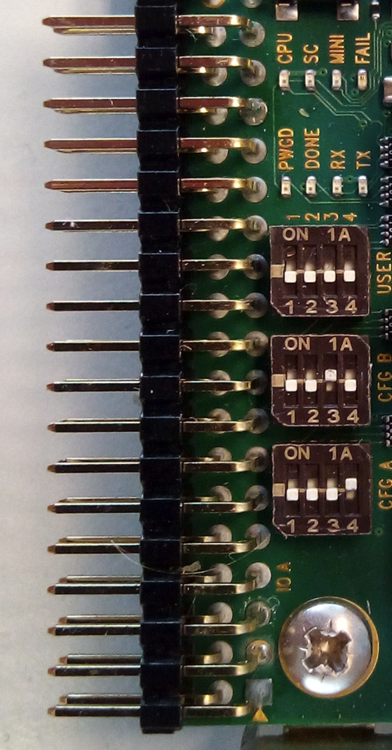
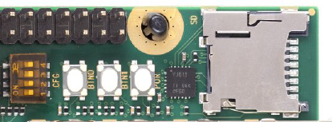
2 Carriers and SOMs –prepare boards
PE1 with ZU4EV: Mercury_PE1_User_Manual_V06.pdf
DIP Switches
CFG A = [1: OFF, 2: OFF, 3: OFF, 4: ON]
CFG B = [1: OFF, 2: OFF, 3: ON, 4: OFF]
-> Set for
JTAG
ST1 with ZU2CG Mercury_ST1_User_Manual_V03.pdf
Dip Switch:
CFG A = [1: OFF, 2: OFF, 3: ON, 4: ON]
Set for JTAG

Slide 8
2 Carriers and SOMs
MCT Tool
Connect USB Cable to PE1 or ST1 FIRST: USB, Second: POWER
Disonnect other FTDI devices from your PC before proceeding
Power: 12V on
Open MCT Tool from Enclustra
1. Open the MCT and click the Enumerate button
2. In the Action pane, navigate to the FTDI Configuration section
3. For the Device mode, select Xilinx JTAG
4. Press the Set device mode button and wait the process to complete.
5. Detach and reconnect all USB cables and power afterwards.
Close Enclustra MCT Tool
FTDI drivers help:
https://github.schneider-electric.com/DIP/HDF-Xilinx-US-plus/blob/master/docs/Enclustra_board.md

Slide 9
3 Hello World
PE1 with ZU4EV
Import Project from Teams:
4EV_Hands-on.ide.zip
In Vitis, Menu „File“ ->Import Vitis project
->Build Project
ST1 with ZU2CG
Import Project from Teams:
ZU2CG_example.zip
In Vitis, Menu „File“ ->Import Vitis project
->Build Project

Slide 10
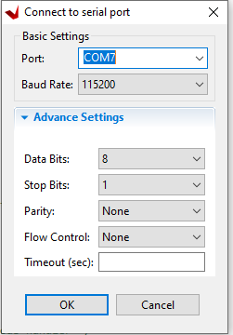
3 Hello World
Serial Interface
In Vitis select Tab „ Vitis serial Terminal“ on left bottom window.
Click on „+“ to add serial port:
Select your serial port from device tree (must be not com7 )
Baud rate and settings are default by Zynq Ultrascale+

Slide 11
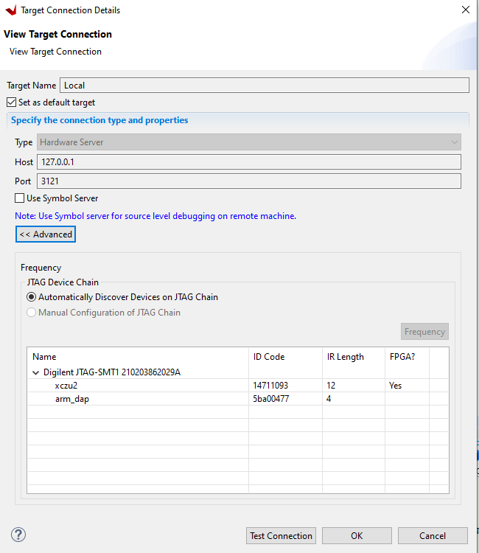
3 Hello World Debug Interface In Vitis , click on Button „Launch Target Connections“ on Top
With USB cable (FTDI JTAG)
If no device appears, power on board
Xcu2 and arm_dap2 must be displayed
With Platform Cable DLC10

Slide 12
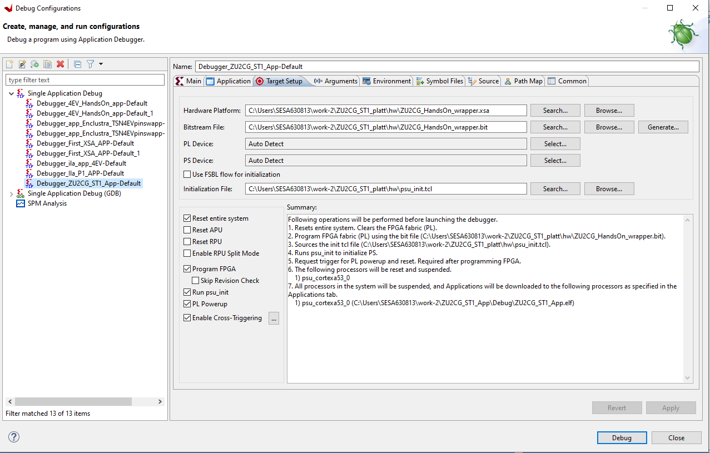
3 Hello World Debug
Debug
Click on ZU2CG_ST1_App in left Explorer window (right click)
Select „Debug As“ → Debug Configuration …
In tab „Main“ the choosen connection must fit to the HW target platform
For each SOM (Zu2CG,ZU4EV) a dedicated platform project is required
Tips:
A reboot can make Vitis fast again.
Take care of correctnes of the debug configuration
Look at the ST1 Manual

Slide 13
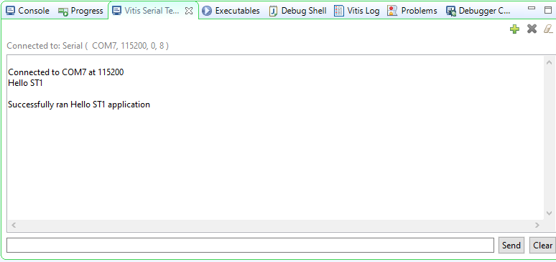
3 Hello World Output
Click on RUN
You should see the LEDs blink on the SOM
You can set breakpoints, change the program

Slide 14
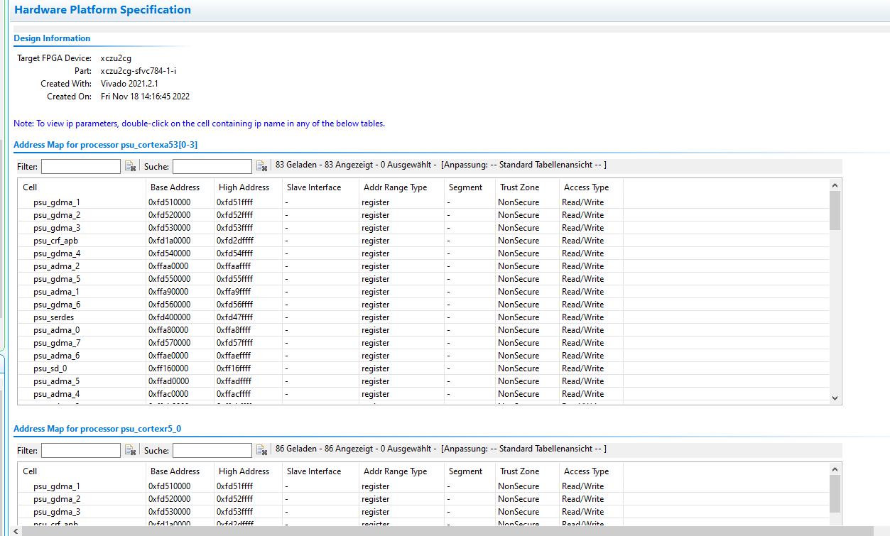
3 Hello World addons
XSA file Informations
Go to the platform folder , and click on your XSA File
The Hardware Platform specification should appear
-> search in „Filter“ : gpio
Click on „axi_gpio_0 , and you get config informations

Slide 15
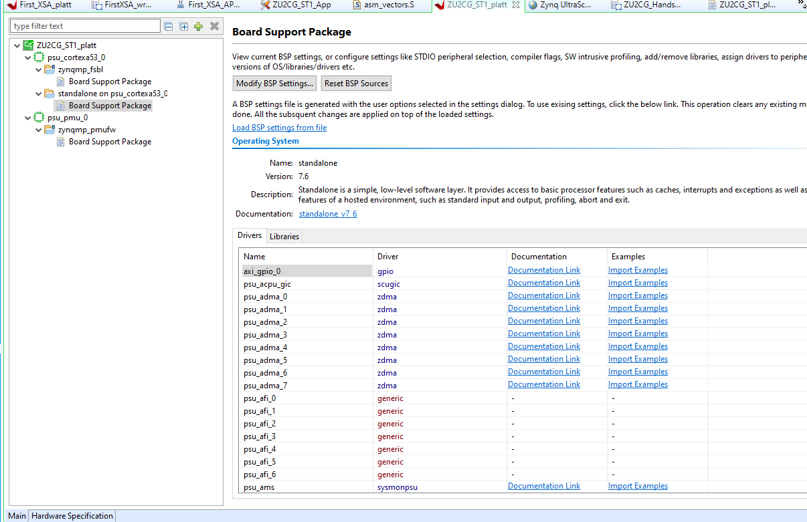
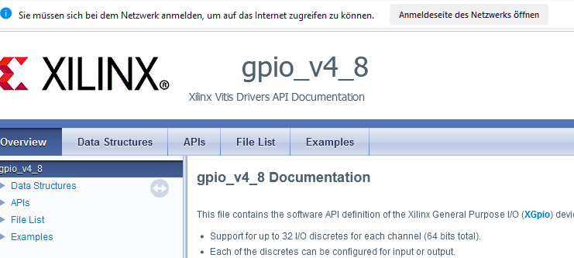
3 Hello World addons
Platform.spr file Informations
Go to the platform folder , and click on platform.xpr
The bordt support package should appear
Click on board support package in standalone on psu:cortexA53_0
Click in line „axi_gpio_0 , on documentation link.
This should be appear in your browser:

Slide 16
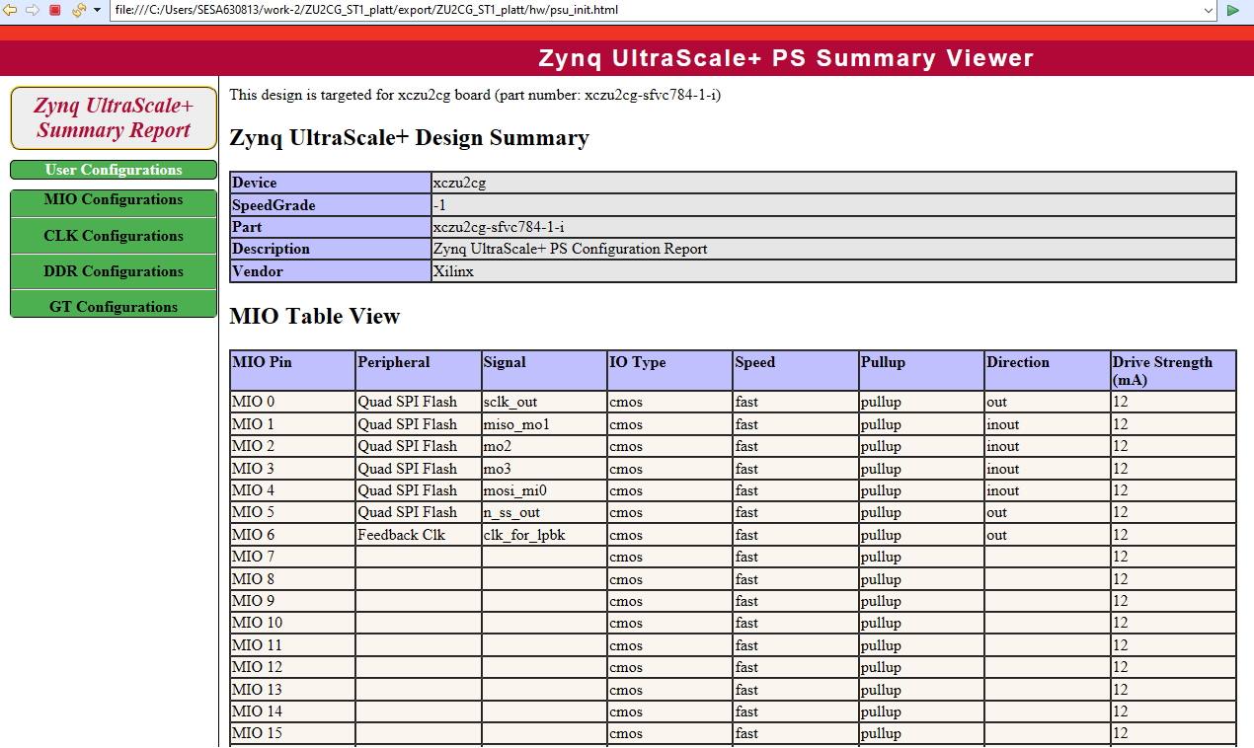
Hello World addons
Psu_init.html
Psu_init.html shows the MIO Configuration of the Processor side from the Zynq Ultrascale+
On MIO38 and MIO39 is the UART0 for serial in/out
CLK, DDR and GT configuration

Slide 17
4 Import XSA file from Vivado in Vitis
Make platform Project
1. Go to Vitis Menu ,select „File“ -> New and click on „Platform Project“
2. Enter a name for your Platform Project (Handson_platt)
3. Create new platform from hardware (XSA): Select the XSA file in the teams folder: ZU2CG_HandsOn_wrapper.xsa OS: Standalone, Processor: choose between psu_cortex_a53_0 or psu_cortexr5_0
4 Click „Finish“
On next window some informations. BSP settings could be modified, but not needed now

Slide 18
4 Import XSA file from Vivado
Make application Project
1. Go to Vitis Menu ,select „File“ -> New and click on „Application Project“
2. Click on „next“ and select your platform project created in last step.
Platform Info should be an Xcu2cg-sfvc784-1-i for the ST1 carrier project(784 is the number of MPSoC pins)
3. Enter your Application project name (Handson_app)
4. click „next“
5. click „next“
6. select „Hello World“ Template
7. rename „helloworld.c“ file in your app folder
8. Build app (rmc on app) „Build Project“ then will be first platform project bulid , after that app project
Run or debug project

Slide 19
Tips
Vivado
Folder for vivado projects must be: C:\Schneider\ScripingPath
Otherwise cyclance blocks the javascript files from vivado to build an XSA

Slide 20


THANK YOU.

Slide 21
5 Test
Which bus width has the DDR4 memory in this ST1 example
What means „AXI“
How many outputs can one AXI GPIO offer?
How many pins has our selected MPSoC?
What is with ECC in this design?
What will you do with this ST1 board?

